Slide 1
Eniac’s Discount Strategy
Presented by:
Derek Murphy Oleksandra Tkachenko Kwabena Agyei

Slide 2
Introduction
Objective:
Are discounts associated with increased orders and revenue?
Head of marketing:
Discounts improve customer acquisition, satisfaction and retention
Investors have some legitimate concerns:
Aggressive discounts are risky
Latest results show increased orders but decrease in revenue
Scope of analysis:
Orders and discounts across product categories 2017-2018

Slide 3
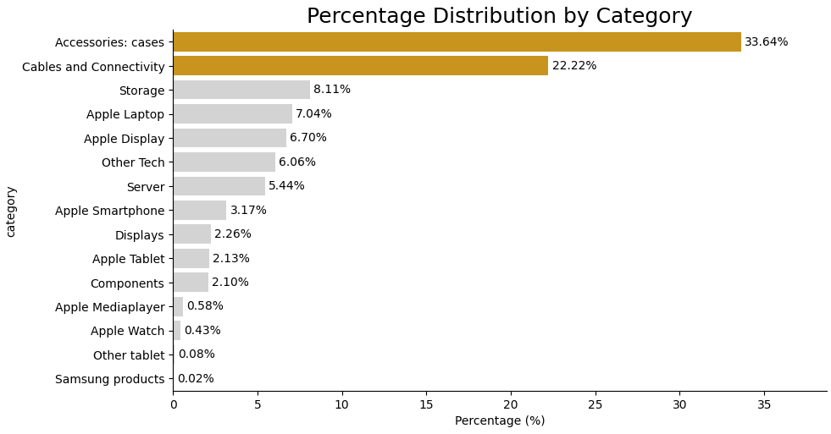
Products Distribution by Category
15 categories have been identified for analysis. Most products belong to 2 categories, which account for 56% of the Eniac’s portfolio, namely:
Accessories: cases (34%)
Cables and Connectivity (22%)

Slide 4
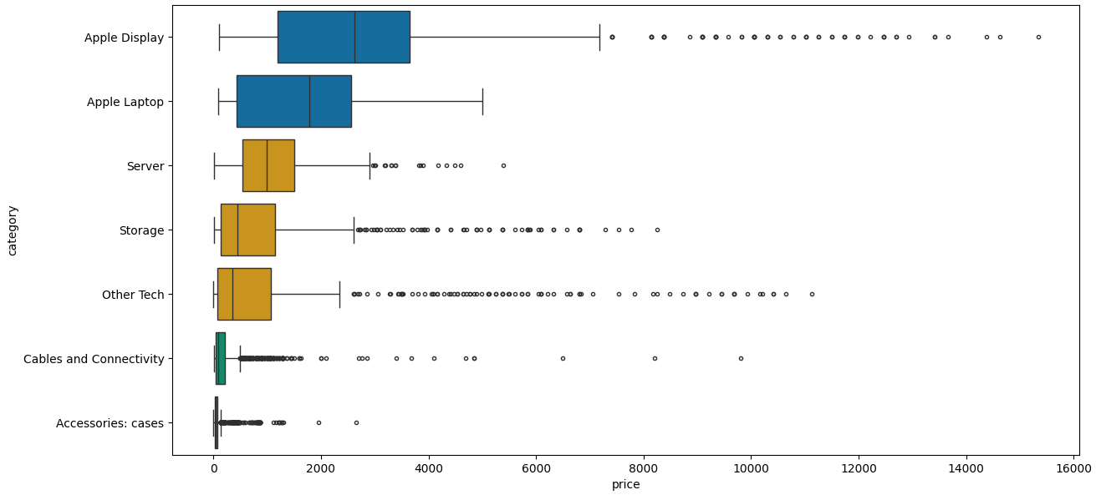
Price Distribution of Products by Category*
* Categories with over 500 items have been included, small items - excluded.
Apple Displays and Laptops dominate the high-price segment.
Accessories and Cables operate in a low-price, high-volume space.
Several categories show strong price distribution, increasing discount risk.
Notes:
Each box shows the typical price range per category (median + spread).
Long tails indicate few very expensive items driving revenue.
Why it matters:
Discounting high-spread categories impacts revenue much more than discounting low-price items.
The highest discount risk sits in Apple Displays, Apple Laptops, Storage, Other Tech, and Servers — these categories have wide price ranges and expensive outliers, so even small discounts there create large revenue losses.
This chart shows that most of Eniac’s revenue risk sits in a small number of high-price products, so broad discounting there can destroy value faster than it creates volume.
Accessories, Cables, Apple Watch, and Components are concentrated at the low-price range, showing mostly affordable items.
Apple Laptop, Storage, and Other Tech show broader spreads, meaning mixed pricing within those categories.
The white dot marks the median price, and the thick bar shows the interquartile range.

Slide 5
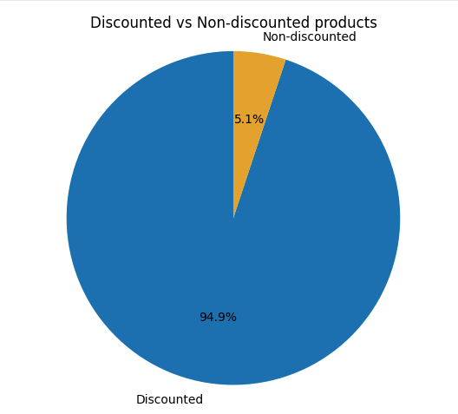
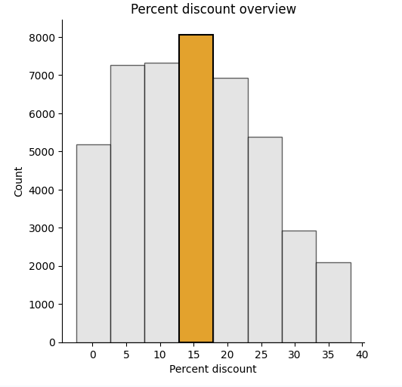
Discounting Policy Across Products
Most products are discounted (~42k vs 2k)
Discounts cluster strongly around 15%

Slide 6
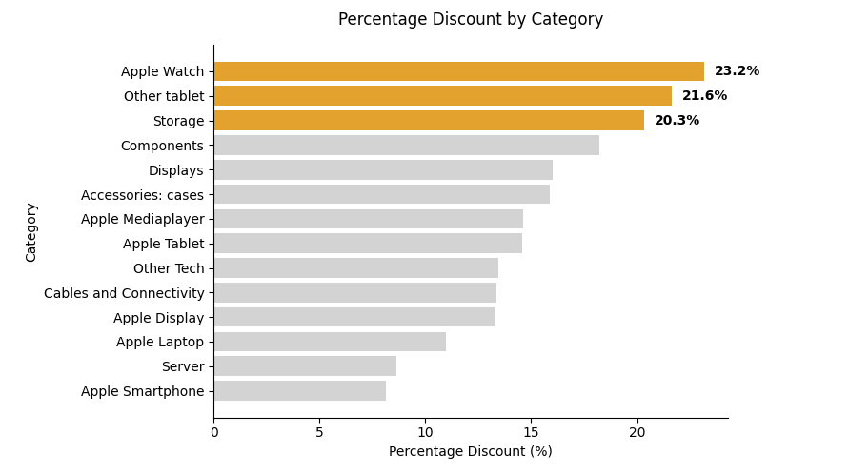
Percent discount per product category
Highest discounted categories ranges between 20 to 23%

Slide 7
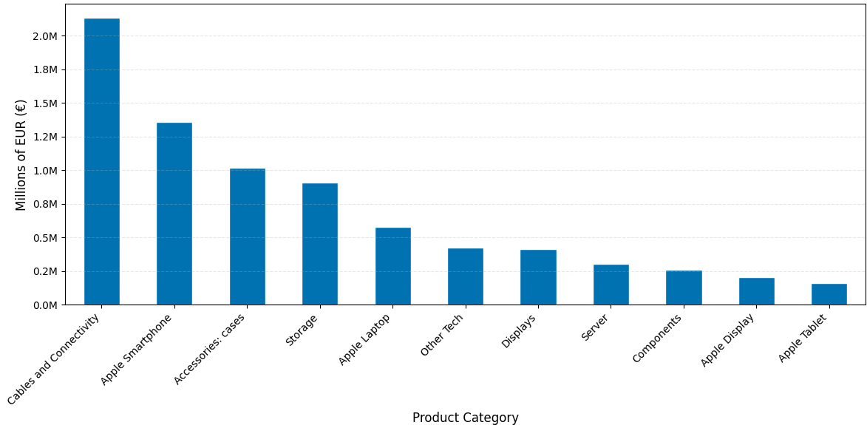
Revenue across Products (Major Categories)

Slide 8
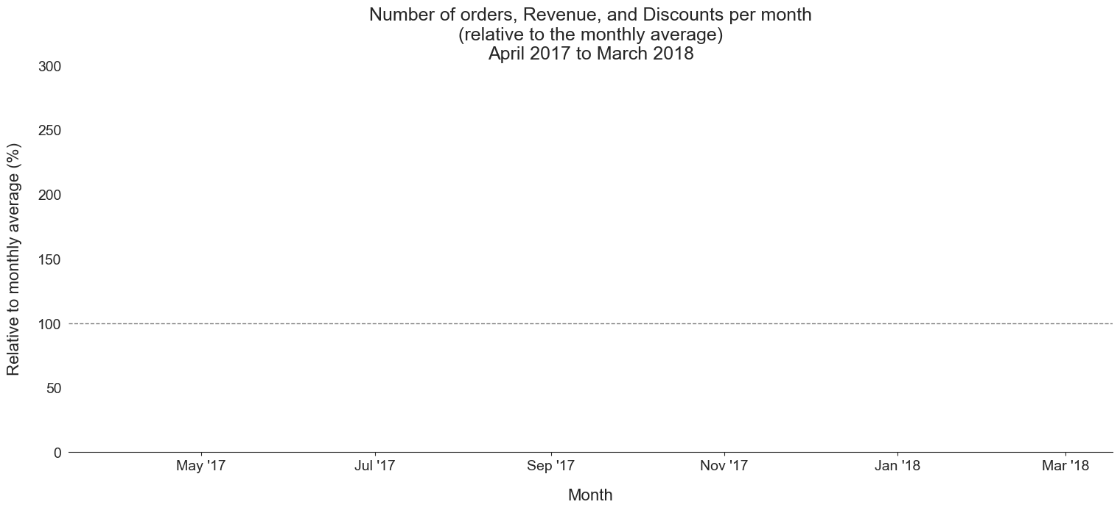
Little evidence that aggressive discounts drive more sales

Slide 9
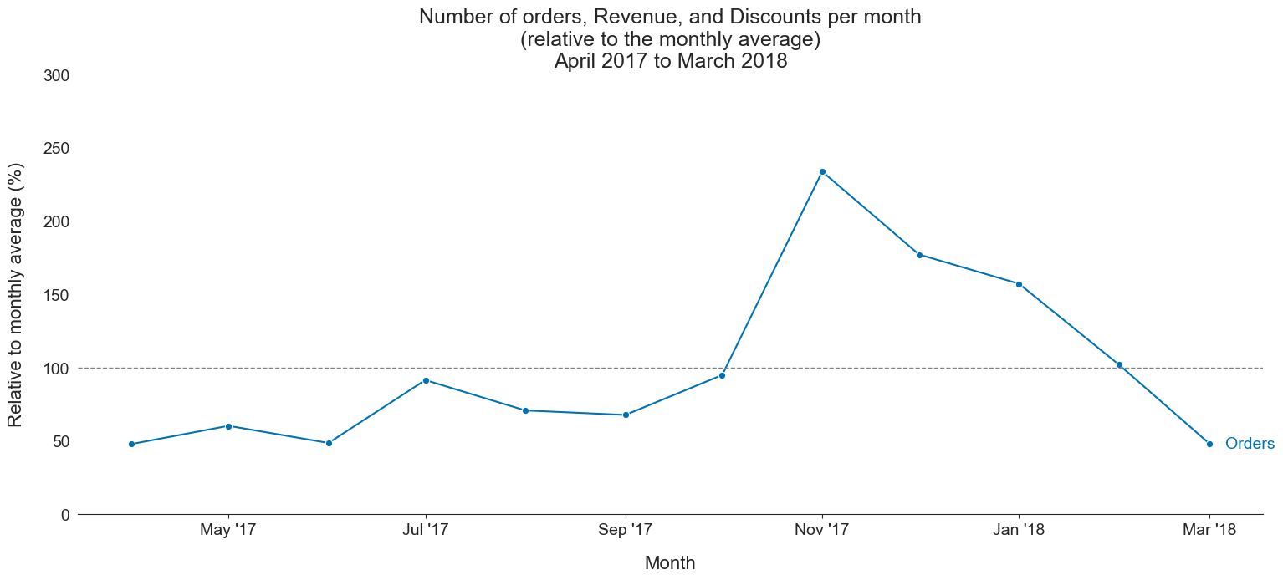
Little evidence that aggressive discounts drive more sales

Slide 10
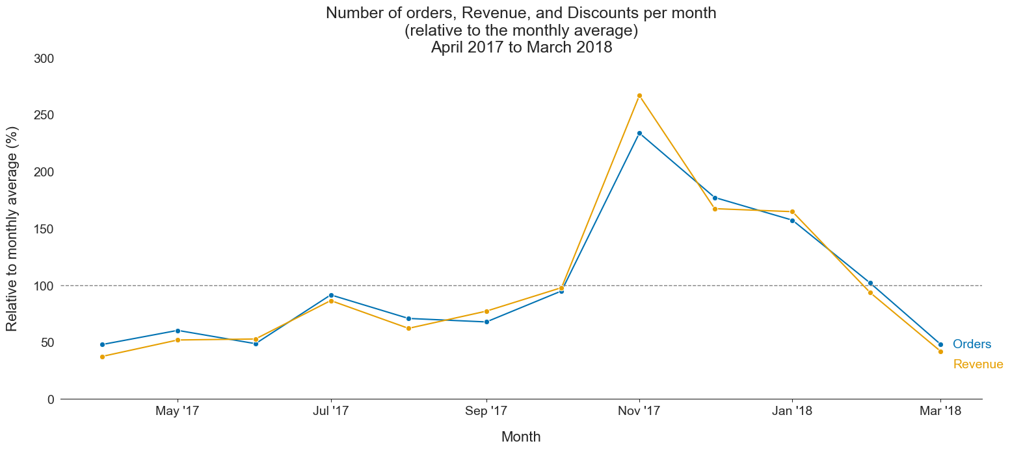
Little evidence that aggressive discounts drive more sales
Black Friday & Cyber Monday

Slide 11
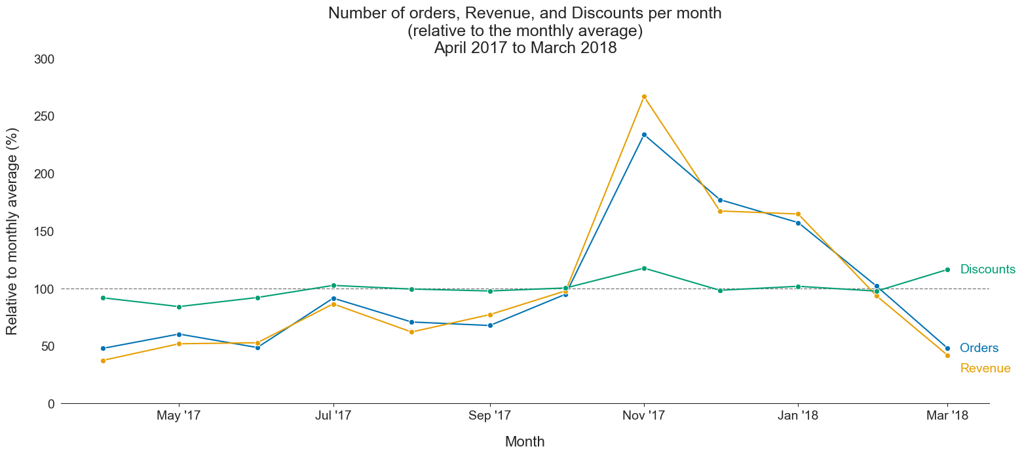
Little evidence that aggressive discounts drive more sales
discounts orders and revenue
discounts orders and revenue

Slide 12
Recommendation
Avoid aggressive discounts (especially on categories with large price distribution + low volume share)
Explicit testing is required to understand how discounts drive sales & revenue (as well as customer satisfaction, acquisition, and retention)

Slide 13
Summary
Context:
Biggest product categories are “Accessories: cases” and “Cables and Connectivity”
Range of prices vary considerably across and within categories
We have offered discounts on most products at some point, typically around 15%
Discounts:
A slight increase in discounts in Nov 2017 coincided with increased orders and revenue, particularly on Black Friday and Cyber Monday
Similar discounts in March 2018 coincided with decreased orders and revenue

Slide 14
Recommendations for data collection
A lot of corrupted data, particularly regarding prices:
Data entry validation when entering price information
Notes column (extra information for exceptional cases)
Add shipping cost information
Product categorisation:
Pre-defined categories for products
Short and clear name column

